Slide 1
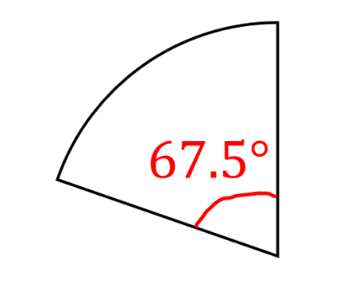
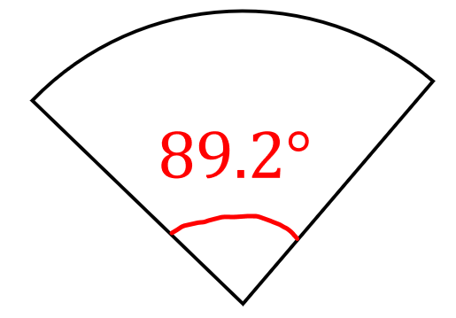
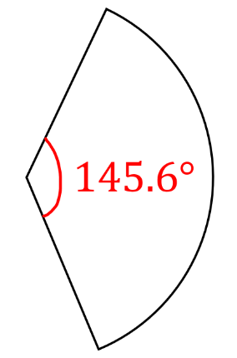
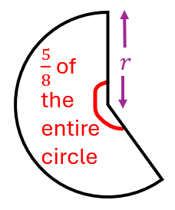
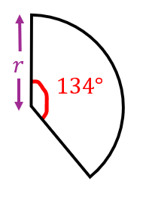
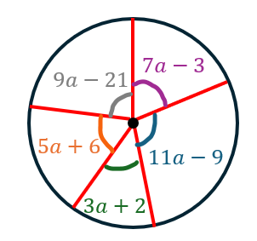
Challenge worksheet
All questions can be attempted after set 1 of independent work questions.
Question 1: Express the following sectors as simplified fractions of their original circles. Attempt first without your calculator.
Question 2: A circle is divided into congruent sectors, each with a central angle of 18°. How many such sectors fit exactly into the circle?
a)
b)
Question 3: Show that the below two sectors, with the same radius, cannot fit exactly together. How many more degrees are needed to make them fit?
c)
Question 4: Express the sector with a central angle that is a multiple of 5° as a simplified fraction of the full circle.

