Slide 1
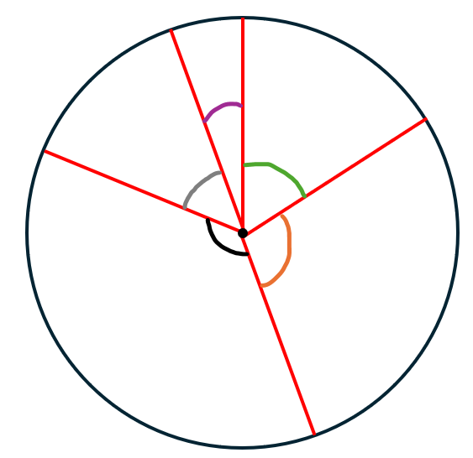
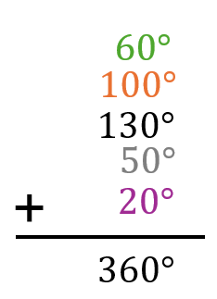





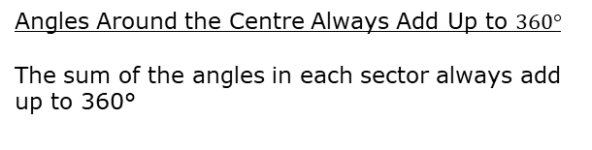
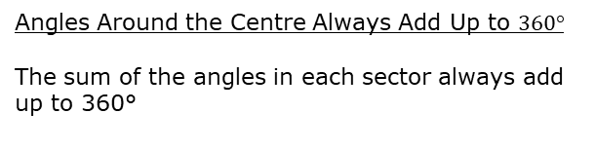

Key Info and Concepts
What is a sector?
A sector is a portion of a circle, defined by two radii and the arc between them.
Minor and Major sectors
A minor sector is less than half of the circle, while a major sector is more than half of the circle.
Angles Around the Centre Always Add Up to $360°$
The sum of the angles in each sector always add up to 360°
$$20°$$
Arc Length
$$60°$$
$$50°$$
r
Minor sector
Major sector
$$130°$$
$$100°$$
r
Centre of circle
Key Info and Concepts
What is a sector?
A sector is a portion of a circle, defined by two radii and the arc between them.
Minor and Major sectors
A minor sector is less than half of the circle, while a major sector is more than half of the circle.
Angles Around the Centre Always Add Up to $360°$
The sum of the angles in each sector always add up to 360°
$$20°$$
Arc Length
$$50°$$
$$60°$$
r
Minor sector
Major sector
$$130°$$
$$100°$$
r
Centre of circle

