Slide 1
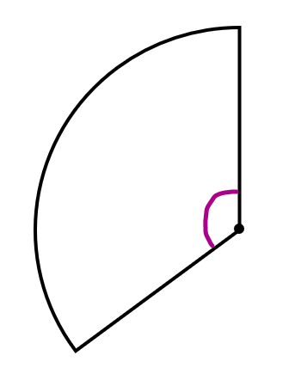
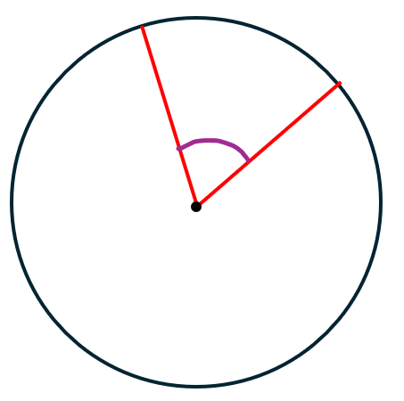
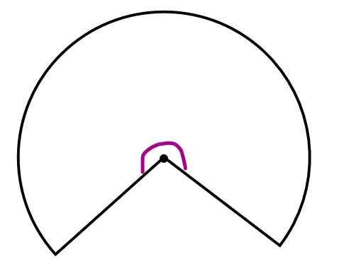
Examples
Question 1
Express the minor sector as a simplified fraction of the entire circle
Question 2
Express the minor sector as a simplified fraction of its original circle
Question 3
Express the major sector as a simplified fraction of its original circle
$$60°$$
$$135°$$
$$260°$$
Examples
Question 1
Express the minor sector as a simplified fraction of the entire circle
Question 2
Express the minor sector as a simplified fraction of its original circle
Question 3
Express the major sector as a simplified fraction of its original circle
$$60°$$
$$135°$$
$$260°$$

