Slide 1
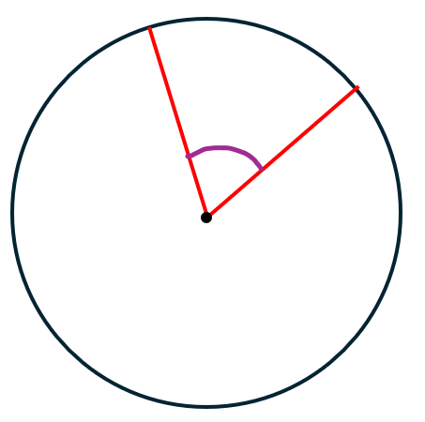
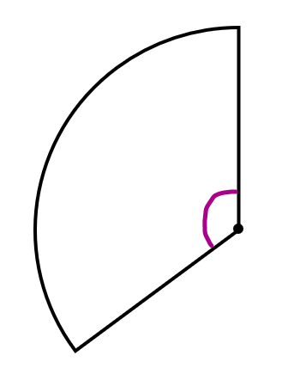
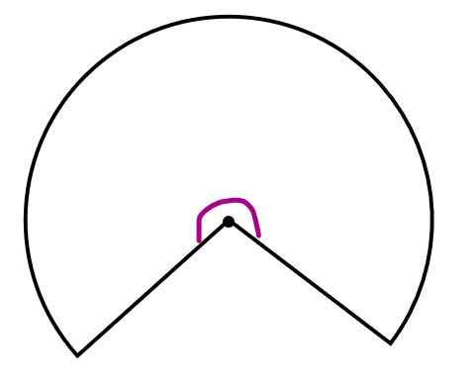
Examples
Examples
Examples
Question 1
Express the minor sector as a simplified fraction of the entire circle
Question 1
Express the minor sector as a simplified fraction of the entire circle
Question 1
Express the minor sector as a simplified fraction of the entire circle
$$60°$$
$$60°$$
$$60°$$
Question 2
Express the minor sector as a simplified fraction of its original circle
Question 2
Express the minor sector as a simplified fraction of its original circle
Question 2
Express the minor sector as a simplified fraction of its original circle
$$135°$$
$$135°$$
$$135°$$
Question 3
Express the major sector as a simplified fraction of its original circle
Question 3
Express the major sector as a simplified fraction of its original circle
Question 3
Express the major sector as a simplified fraction of its original circle
$$260°$$
$$260°$$
$$260°$$

