Slide 1
DATE
STARTER
Introduction to Sectors
Name the different parts of circle
Find the missing angle $x$
3) Saskia has 3 dogs and 4 cats. What fraction of her pets are dogs?
4) Is 376 divisible by 5?
5) $360÷8=$
6) Simplify fully: $\frac{70}{80}$
7) Simplify fully: $\frac{52}{108}$
8) Simplify fully: $\frac{19.2}{57.6}$
?
?
9) Find $a$
?
$$7a+4$$
$$6a−3$$
$$7a+12°$$
$$123°$$
$$3a+2$$
$$37°$$
$$142°$$
$$x$$

Slide 2
DATE
STARTER
Introduction to Sectors
Name the different parts of circle
Find the missing angle $x$
3) Saskia has 3 dogs and 4 cats. What fraction of her pets are dogs?
4) Is 376 divisible by 5?
5) $360÷8=$
6) Simplify fully: $\frac{70}{80}$
7) Simplify fully: $\frac{52}{108}$
8) Simplify fully: $\frac{19.2}{57.6}$
$$\frac{3}{7}$$
? = Diameter
? = Chord
?
No
?
? = Radius
9) Find $a$
?
8
$$7a+4$$
$$\frac{7}{8}$$
$$6a−3$$
$$7a+12°$$
$$123°$$
$$\frac{13}{27}$$
$$3a+2$$
$$37°$$
$$142°$$
$$x$$
$$\frac{1}{3}$$
$$a=15$$
$$x=58°$$

Slide 3
Conceptual Teaching

Slide 4
What is a Sector?
Start with a circle
Arc Length
Mark the centre of the circle
Sectors are often shown on their own, without the rest of the circle.
Radius
Draw two radii
They are also usually not shaded.
Radius
Connect the radii with an arc
Centre of Circle
The red ‘pizza slice’ is called a sector.

Slide 5
Mini Whiteboards

Slide 6
What is the length of the radius?
9 cm
7 cm

Slide 7
What is the length of the radius?
9 cm
7 cm
7 cm

Slide 8
What is the length of the arc?
5 cm
26 cm

Slide 9
What is the length of the arc?
26 cm
5 cm
26 cm

Slide 10
What is the missing length?
?
17 m
3 m

Slide 11
What is the missing length?
?
17 m
? = 3 m
3 m

Slide 12
What is the missing length?
46 mm
?
8 mm

Slide 13
What is the missing length?
46 mm
?
? = 8 mm
8 mm

Slide 14
Which point corresponds to the centre?
E
B
A
D
C

Slide 15
Which point corresponds to the centre?
E
B
A
D
D
C

Slide 16
Discuss With Your Partner

Slide 17
My best sector yet!

Slide 18
My best sector yet!
The red lines are not radii as they do not extend from the centre of the circle.
To be a sector, a shape must be enclosed by two radii and an arc.
This is not a sector.

Slide 19
Let me try again…

Slide 20
Let me try again…
This is not a sector as there is no arc.
There is a chord instead of an arc.

Slide 21
Conceptual Teaching

Slide 22
Major and Minor Sectors and Arcs
Connect the radii with a minor arc
Connect the radii with a major arc
Start with 2 circles
Mark the centres
Minor arc
Minor Sector
Major Sector
Draw 2 radii on each circle
Major arc

Slide 23
Planner Colours
Minor
Major

Slide 24
Major or minor?
Minor
Major

Slide 25
Major or minor?
Minor
Major

Slide 26
Major or minor?
Minor
Major

Slide 27
Major or minor?
Minor
Major

Slide 28
Major or minor?
Minor
Major

Slide 29
Major or minor?
Minor
Major

Slide 30
Major or minor?
Minor
Major

Slide 31
Major or minor?
Minor
Major
Neither (special case)

Slide 32
Conceptual Teaching

Slide 33
Angles Around the Centre Add Up to $360°$
$$20°$$
Start with a circle
Let’s add up the angles:
$$60°$$
Mark the centre
$$50°$$
$$60°$$
$$100°$$
Divide the circle into sectors
$$130°$$
$$100°$$
$$130°$$
$$50°$$
+
$$20°$$
Mark the angle sizes
$$360°$$
We always get $360°$ when we add up the angles around the centre (all the sector angles add up to $360°$).

Slide 34
Worked Example (No Set)

Slide 35
Find the missing angle $x$
Step 1: Add up the angles we have
$$131°+82°+63°+21°=297°$$
Step 2: Subtract from $360°$
$$360°−297°=63°$$
Final answer: $x=63°$
$$131°$$
$$82°$$
$$x$$
$$63°$$
$$21°$$

Slide 36
Mini Whiteboards

Slide 37
Challenge: Find the value of $a$
Find the missing angle $x$
$$61°$$
$$83°$$
$$2a$$
$$190°$$
$$16°$$
$$65°$$
$$67°$$
$$3a$$
$$x$$
$$3a+10$$

Slide 38
Challenge: Find the value of $a$
Find the missing angle $x$
$$61°$$
$$83°$$
$$2a$$
$$190°$$
$$16°$$
$$65°$$
$$67°$$
$$3a$$
$$x$$
$$3a+10$$
$x=68$°
$a=20$°

Slide 39
Worked Examples (Set 1)

Slide 40
Question 1
Express the minor sector as a simplified fraction of the entire circle
Step 1: The required fraction can be obtained using $\frac{angle}{360}$.
$$\frac{60}{360}$$
Step 2: Simplify the fraction (if possible) fully
$$\frac{60}{360}=\frac{1}{6}$$
Final answer: $\frac{1}{6}$
$$60°$$

Slide 41
Question 2
Express the sector as a simplified fraction of its original circle
Step 1: The required fraction can be obtained using $\frac{angle}{360}$.
$$\frac{135}{360}$$
Step 2: Simplify the fraction (if possible) fully
$$\frac{135}{360}=\frac{3}{8}$$
Final answer: $\frac{5}{12}$
$$135°$$

Slide 42
Question 3
Express the sector as a simplified fraction of its original circle
Step 1: The required fraction can be obtained using $\frac{angle}{360}$.
$$\frac{260}{360}$$
Step 2: Simplify the fraction (if possible) fully
$$\frac{260}{360}=\frac{13}{18}$$
Final answer: $\frac{13}{18}$
$$260°$$

Slide 43
Mini Whiteboards

Slide 44
Express the minor sector as a simplified fraction of the entire circle
$$30°$$

Slide 45
Express the minor sector as a simplified fraction of the entire circle
$$\frac{30}{360}=\frac{1}{12}$$
$$30°$$

Slide 46
Express the sector as a simplified fraction of its original circle
$$120°$$

Slide 47
Express the sector as a simplified fraction of its original circle
$$\frac{120}{360}=\frac{1}{3}$$
$$120°$$

Slide 48
Express the sector as a simplified fraction of its original circle
$$215°$$

Slide 49
Express the sector as a simplified fraction of its original circle
$$\frac{215}{360}=\frac{43}{72}$$
$$215°$$

Slide 50
Independent Work (Set 1)

Slide 51
Express the sectors as simplified fractions of their respective circles
1)
The minor
4)
7)
The major
10)
$$216°$$
$$40°$$
$$100°$$
$$210°$$
$$297°$$
2)
5)
The minor
8)
11)
$$20°$$
$$240°$$
$$90°$$
$$56°$$
3)
6)
9)
$$165°$$
12)
$$45°$$
$$150°$$
The major

Slide 52
Express the sectors as simplified fractions of their respective circles
1)
The minor
4)
7)
The major
10)
$$216°$$
$$\frac{1}{9}$$
$$40°$$
$$\frac{5}{18}$$
$$100°$$
$$\frac{7}{12}$$
$$\frac{3}{5}$$
$$210°$$
$$297°$$
2)
5)
The minor
8)
11)
$$20°$$
$$\frac{2}{3}$$
$$\frac{33}{40}$$
$$\frac{1}{18}$$
$$\frac{1}{4}$$
$$240°$$
$$90°$$
$$56°$$
3)
6)
9)
$$165°$$
12)
$$\frac{1}{8}$$
$$\frac{11}{24}$$
$$45°$$
$$\frac{5}{12}$$
$$150°$$
$$\frac{38}{45}$$
The major

Slide 53
Independent Work (Mixed Questions)

Slide 54
1) Label the sector
3) Describe what a sector is, using words
5) Express the minor sector as a fraction of the entire circle
?
?
$80$°
?
2) What type of sector is the sector in question 1?
4) Find the missing angle $x$
6) Express the sector as a fraction of its original circle
$$x$$
$71$°
$$111°$$
$$131°$$
$225$°

Slide 55
1) Label the sector
3) Describe what a sector is, using words
5) Express the minor sector as a fraction of the entire circle
A sector is a portion of a circle bounded by two radii and the arc between them.
? = Centre
? = Radius
?
$$\frac{2}{9}$$
?
$80$°
?
? = Major arc
2) What type of sector is the sector in question 1?
4) Find the missing angle $x$
6) Express the sector as a fraction of its original circle
$$x$$
$71$°
$x=47$°
$$111°$$
Major sector
$$\frac{5}{8}$$
$$131°$$
$225$°

Slide 56
Challenge Worksheet Questions and Answers

Slide 57
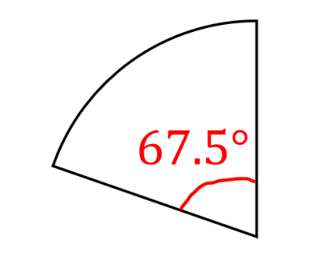
Question 1: Express the following sectors as simplified fractions of their original circles. Attempt first without your calculator.
a)

Slide 58
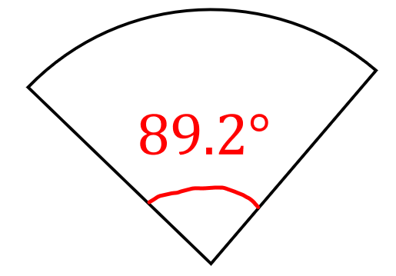
Question 1: Express the following sectors as simplified fractions of their original circles. Attempt first without your calculator.
b)

Slide 59
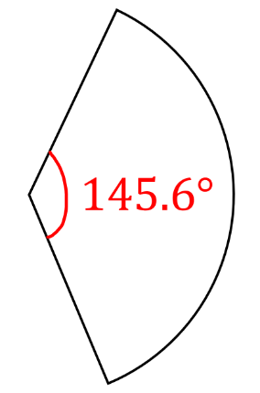
Question 1: Express the following sectors as simplified fractions of their original circles. Attempt first without your calculator.
c)

Slide 60
Question 2: A circle is divided into congruent sectors, each with a central angle of 18°. How many such sectors fit exactly into the circle?

Slide 61
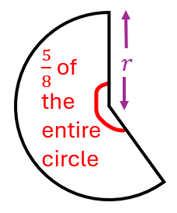
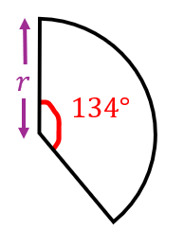
Question 3: Show that the below two sectors, with the same radius, cannot fit exactly together. How many more degrees are needed to make them fit?

Slide 62
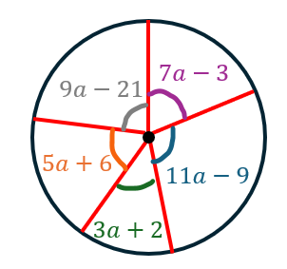
Question 4: Express the sector with a central angle that is a multiple of 5° as a simplified fraction of the full circle.

Slide 63
Question 1: Express the following sectors as simplified fractions of their original circles. Attempt first without your calculator.
a)
$$\frac{3}{16}$$

Slide 64
Question 1: Express the following sectors as simplified fractions of their original circles. Attempt first without your calculator.
b)
$$\frac{223}{900}$$

Slide 65
Question 1: Express the following sectors as simplified fractions of their original circles. Attempt first without your calculator.
c)
$$\frac{91}{225}$$

Slide 66
Question 2: A circle is divided into congruent sectors, each with a central angle of 18°. How many such sectors fit exactly into the circle?
20

Slide 67
Question 3: Show that the below two sectors, with the same radius, cannot fit exactly together. How many more degrees are needed to make them fit?
The major sector has an angle of $225°$ and $225°+134°=259°≠360°$
An extra $1°$ is needed.

Slide 68
Question 4: Express the sector with a central angle that is a multiple of 5° as a simplified fraction of the full circle.
$$\frac{7}{72}$$

Slide 69
Plenary
You can use planner colours, whiteboard or fingers.
A (1)
B (2)
C (3)
D (4)

Slide 70
Fill in the gap:
A minor sector is half of the circle.
A (1)
B (2)
C (3)
D (4)
Equal to
Less than
Exactly
More than

Slide 71
Fill in the gap:
A minor sector is half of the circle.
A (1)
B (2)
C (3)
D (4)
Equal to
Less than
Exactly
More than

Slide 72
What is this part of a sector called?
?
A (1)
B (2)
C (3)
D (4)
Radius
Diameter
Arc
Centre

Slide 73
What is this part of a sector called?
?
A (1)
B (2)
C (3)
D (4)
Radius
Diameter
Arc
Centre

Slide 74
Find $x$
$$120°$$
$$x$$
A (1)
B (2)
C (3)
D (4)
60°
120°
360°
240°

Slide 75
Find $x$
$$120°$$
$$x$$
A (1)
B (2)
C (3)
D (4)
60°
120°
360°
240°

Slide 76
Express the sector as a fraction of its original circle in its simplest form
$15$°
A (1)
B (2)
C (3)
D (4)
$$\frac{1}{24}$$
$$\frac{15}{360}$$
$$\frac{3}{72}$$
$$\frac{1}{15}$$

Slide 77
Express the sector as a fraction of its original circle in its simplest form
$15$°
A (1)
B (2)
C (3)
D (4)
$$\frac{1}{24}$$
$$\frac{15}{360}$$
$$\frac{3}{72}$$
$$\frac{1}{15}$$

