Slide 1
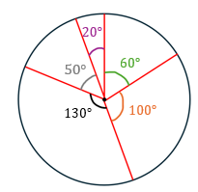
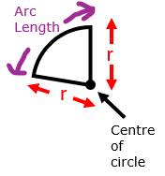
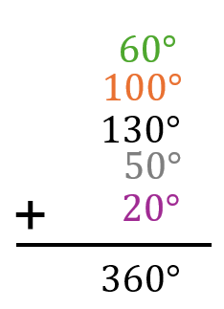
Key Info and Concepts
What is a sector?
A sector is a portion of a circle, defined by two radii and the arc between them.
Minor and Major sectors
A minor sector is less than half of the circle, while a major sector is more than half of the circle.
Angles Around the Centre Always Add Up to $360°$
The sum of the angles in each sector always add up to 360°

